Slide 1

Analysis On Measuring Customer Success of an Online Store
Presented By - Ashish Chaudhary

Slide 2
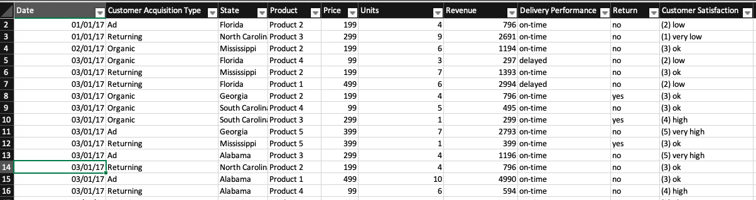
Analysis Of Measuring Customer Success of an Online Store
Data Source : Generated from VBA Script
This data set has 10 Columns And 5781 Rows
Each Row Represents 1 customer transaction with all valuable transaction
We have date of transaction,The way customer acquired,Then Where the customer live, what product he bought,Price of that product,Number of units he bought,Revenue generated from it,Delivery Performance whether on time or Delayed,Return whether the product is returned or not,Customer Satisfaction basically rating from 1 to 5 given by customers.

Slide 3
Problem Statements And Steps
The problem Statement is that we have to analyse the customer success of an Online store.We have to analyse the sales/Revenue With respect to Years/Months , Region , product wise. And we have to analyse the Customer Satisfaction Or Ratings Which Is given by the customers.Now the first things we want to do is to put these data into tables because it allows easily to put the data below second reason is we can refer this data table while creating pivot tables.Then we have to create a pivot table and insert the desired data in it from that we will create different type of pivot charts like Line chart , pie chart,Map chart,Doughnut chart, Waterfall chart etc.
So The Result/Outcome is Suppose when We select 2017 from slicer
Then automatically we get the Month/Year wise Sales,And Its
Respective region through Map Chart,Also We Get Delivery Info
Percentage on time and return percentage,Also With Waterfall Chart We Get Total sales per acquisition,Also We Get Customer satisfaction Through Bar Chart which is basically customer rating of a product From 1 to 5 And Atlas we Get Region Wise Sales Through Pie Chart.Likewise We can select year,Acquisition type, state and products from the slicers to get their respective results in different types of charts which are mentioned in latter slides.

Slide 4
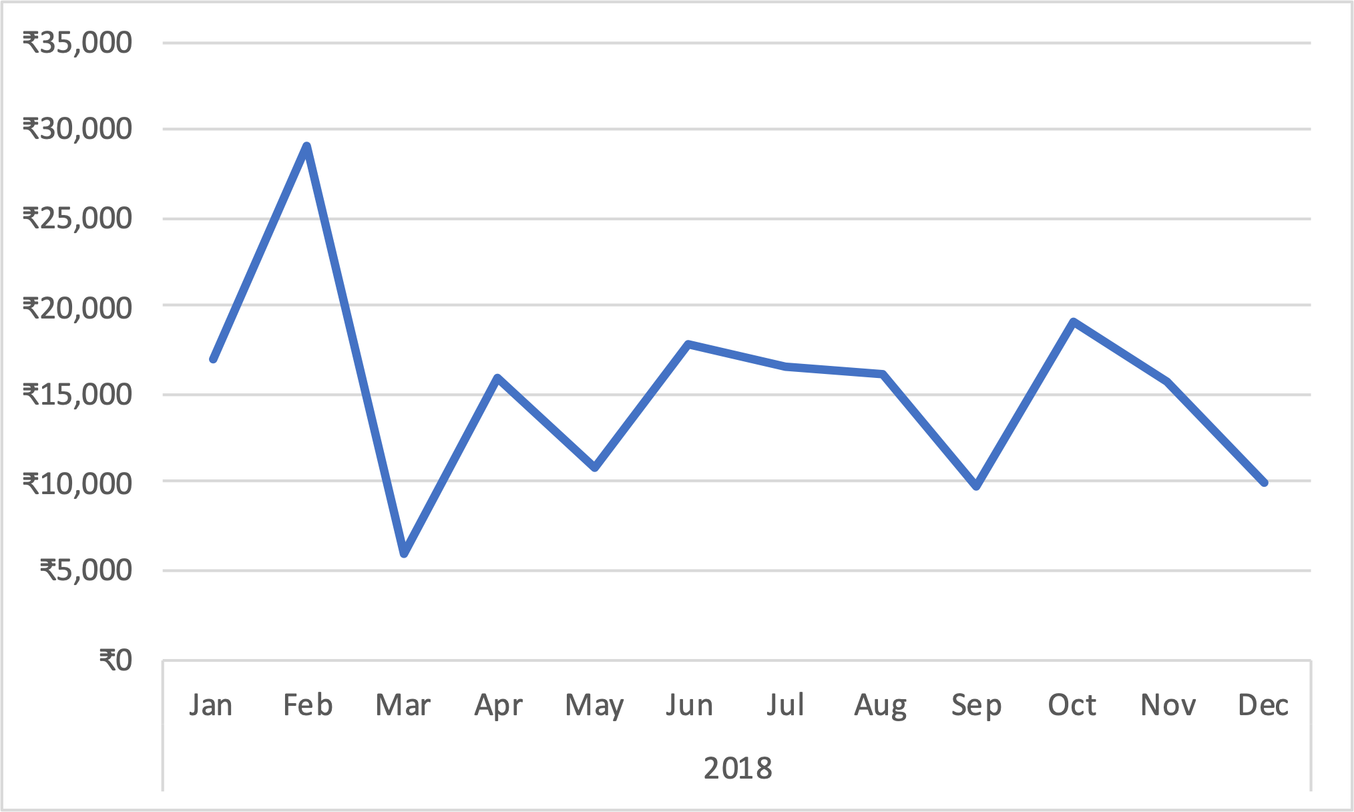
Sales Revenue Line Chart
We create a pivot Table And Drop date field in Rows And Sum of Revenues in Values Box.After that we have to create a line chart from this pivot table.Below is the Line chart of sales revenue with years/Months.

Slide 5
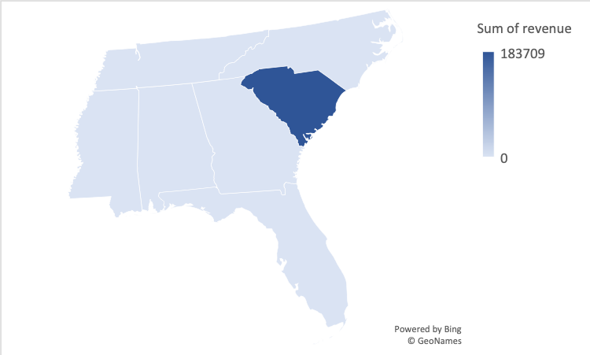
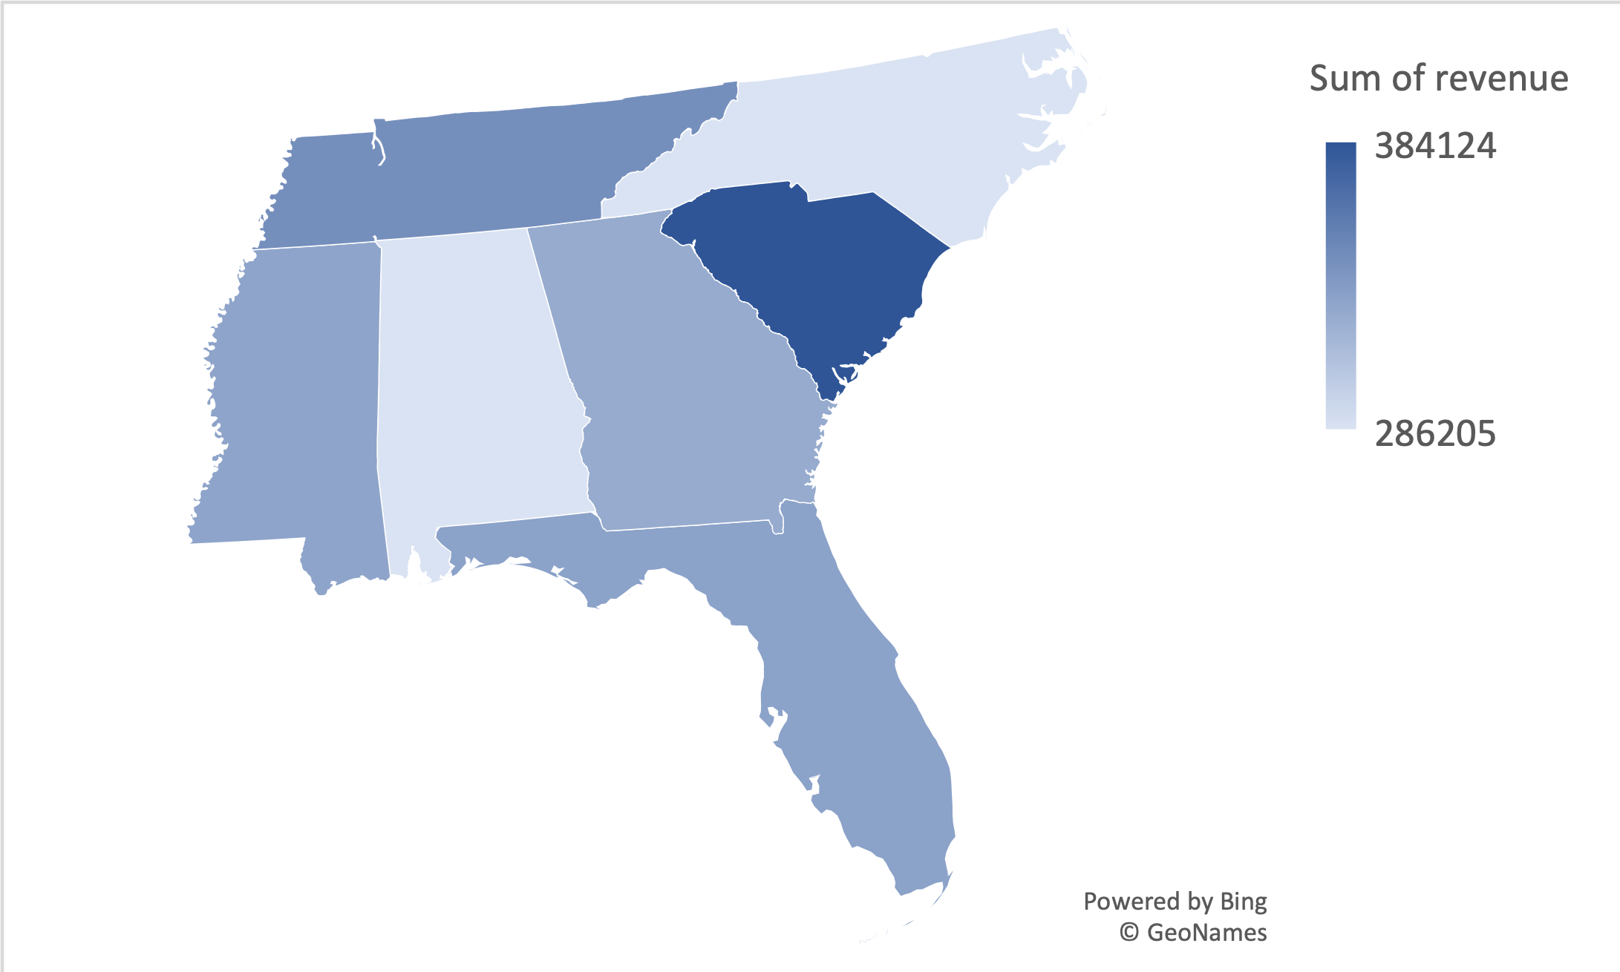
Sales Map Chart
Here we will Visualize sales revenue By U.S states. First we insert pivot table
the we put state fields in column area and revenue field in value area.Below is the map chart of sum of revenue with states.

Slide 6
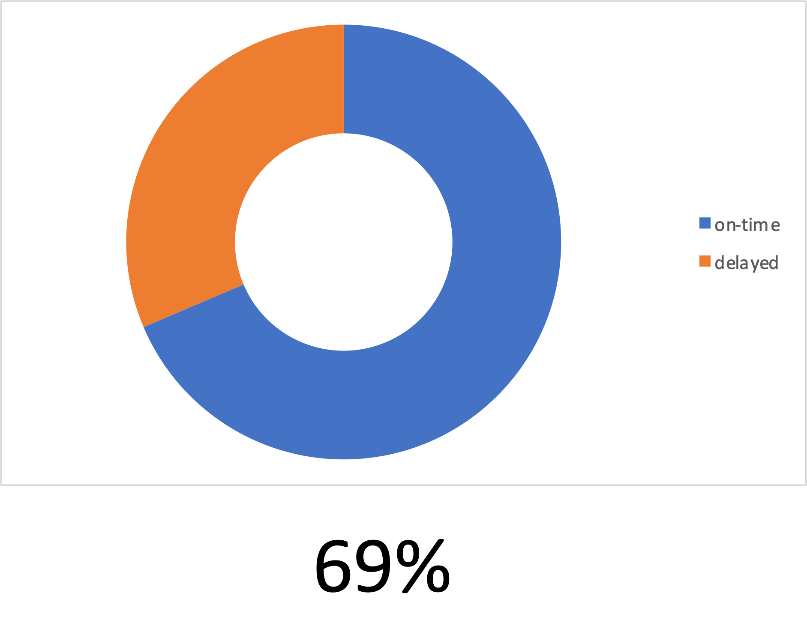
Delivery Doughnut Charts
First insert pivot table then Drag Delivery performance field in rows box and Count of Revenue/no. of transactions in value box.Below is the doughnut chart which tell about the Delivery wheather its on time or delayed.

Slide 7
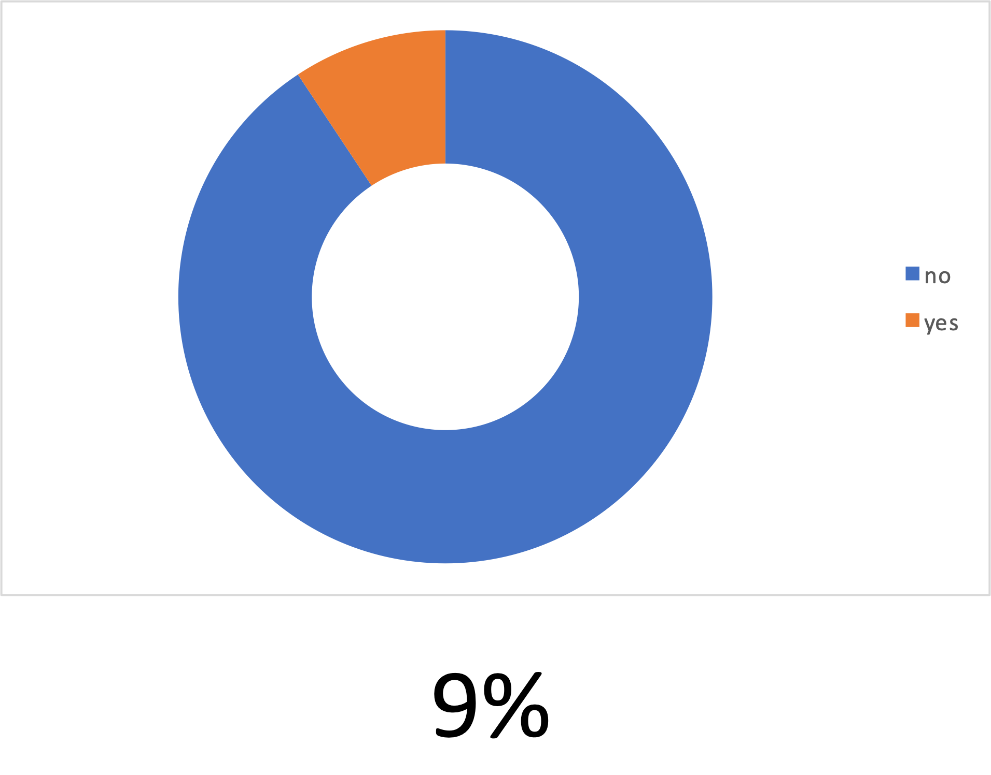
Return rate Doughnut chart
Here first we Insert pivot table the drag Return field into rows area and revenue/numbers of transaction into value friend.Below is the doughnut chart which tell about the Return wheather its Product is returned or not.

Slide 8
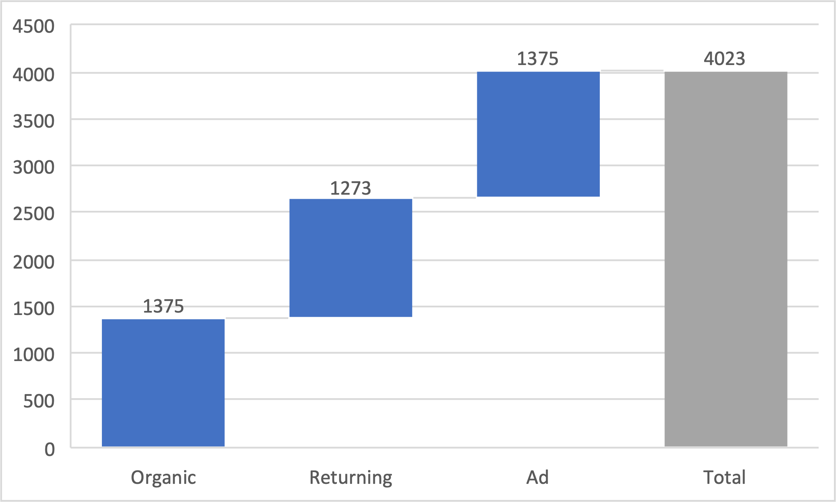
Water Fall Chart
Here to create Water Fall Chart we Insert pivot table then customer acquisition type into rows box and revenue or number of transactions in value box then we create water fall chart.Below is the Waterfall chart which tell about the Acquisition type.

Slide 9
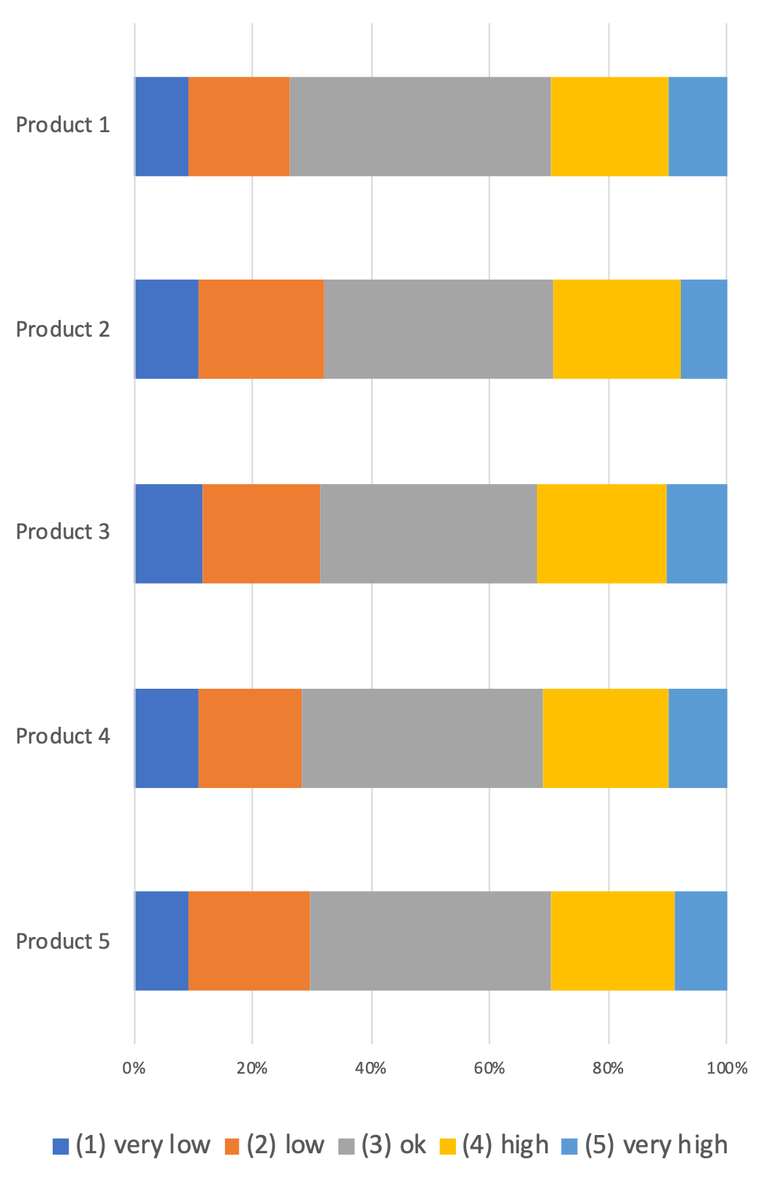
Bar Chart 2-D
Here We Visualizse customers satisfaction split by products.For That We have to
Insert pivot table and then we insert customer satisfaction which is basically a rating from 1 to 5 and products in pivot table. Below is the Bar chart which tell about the Customer satisfaction of the product.

Slide 10
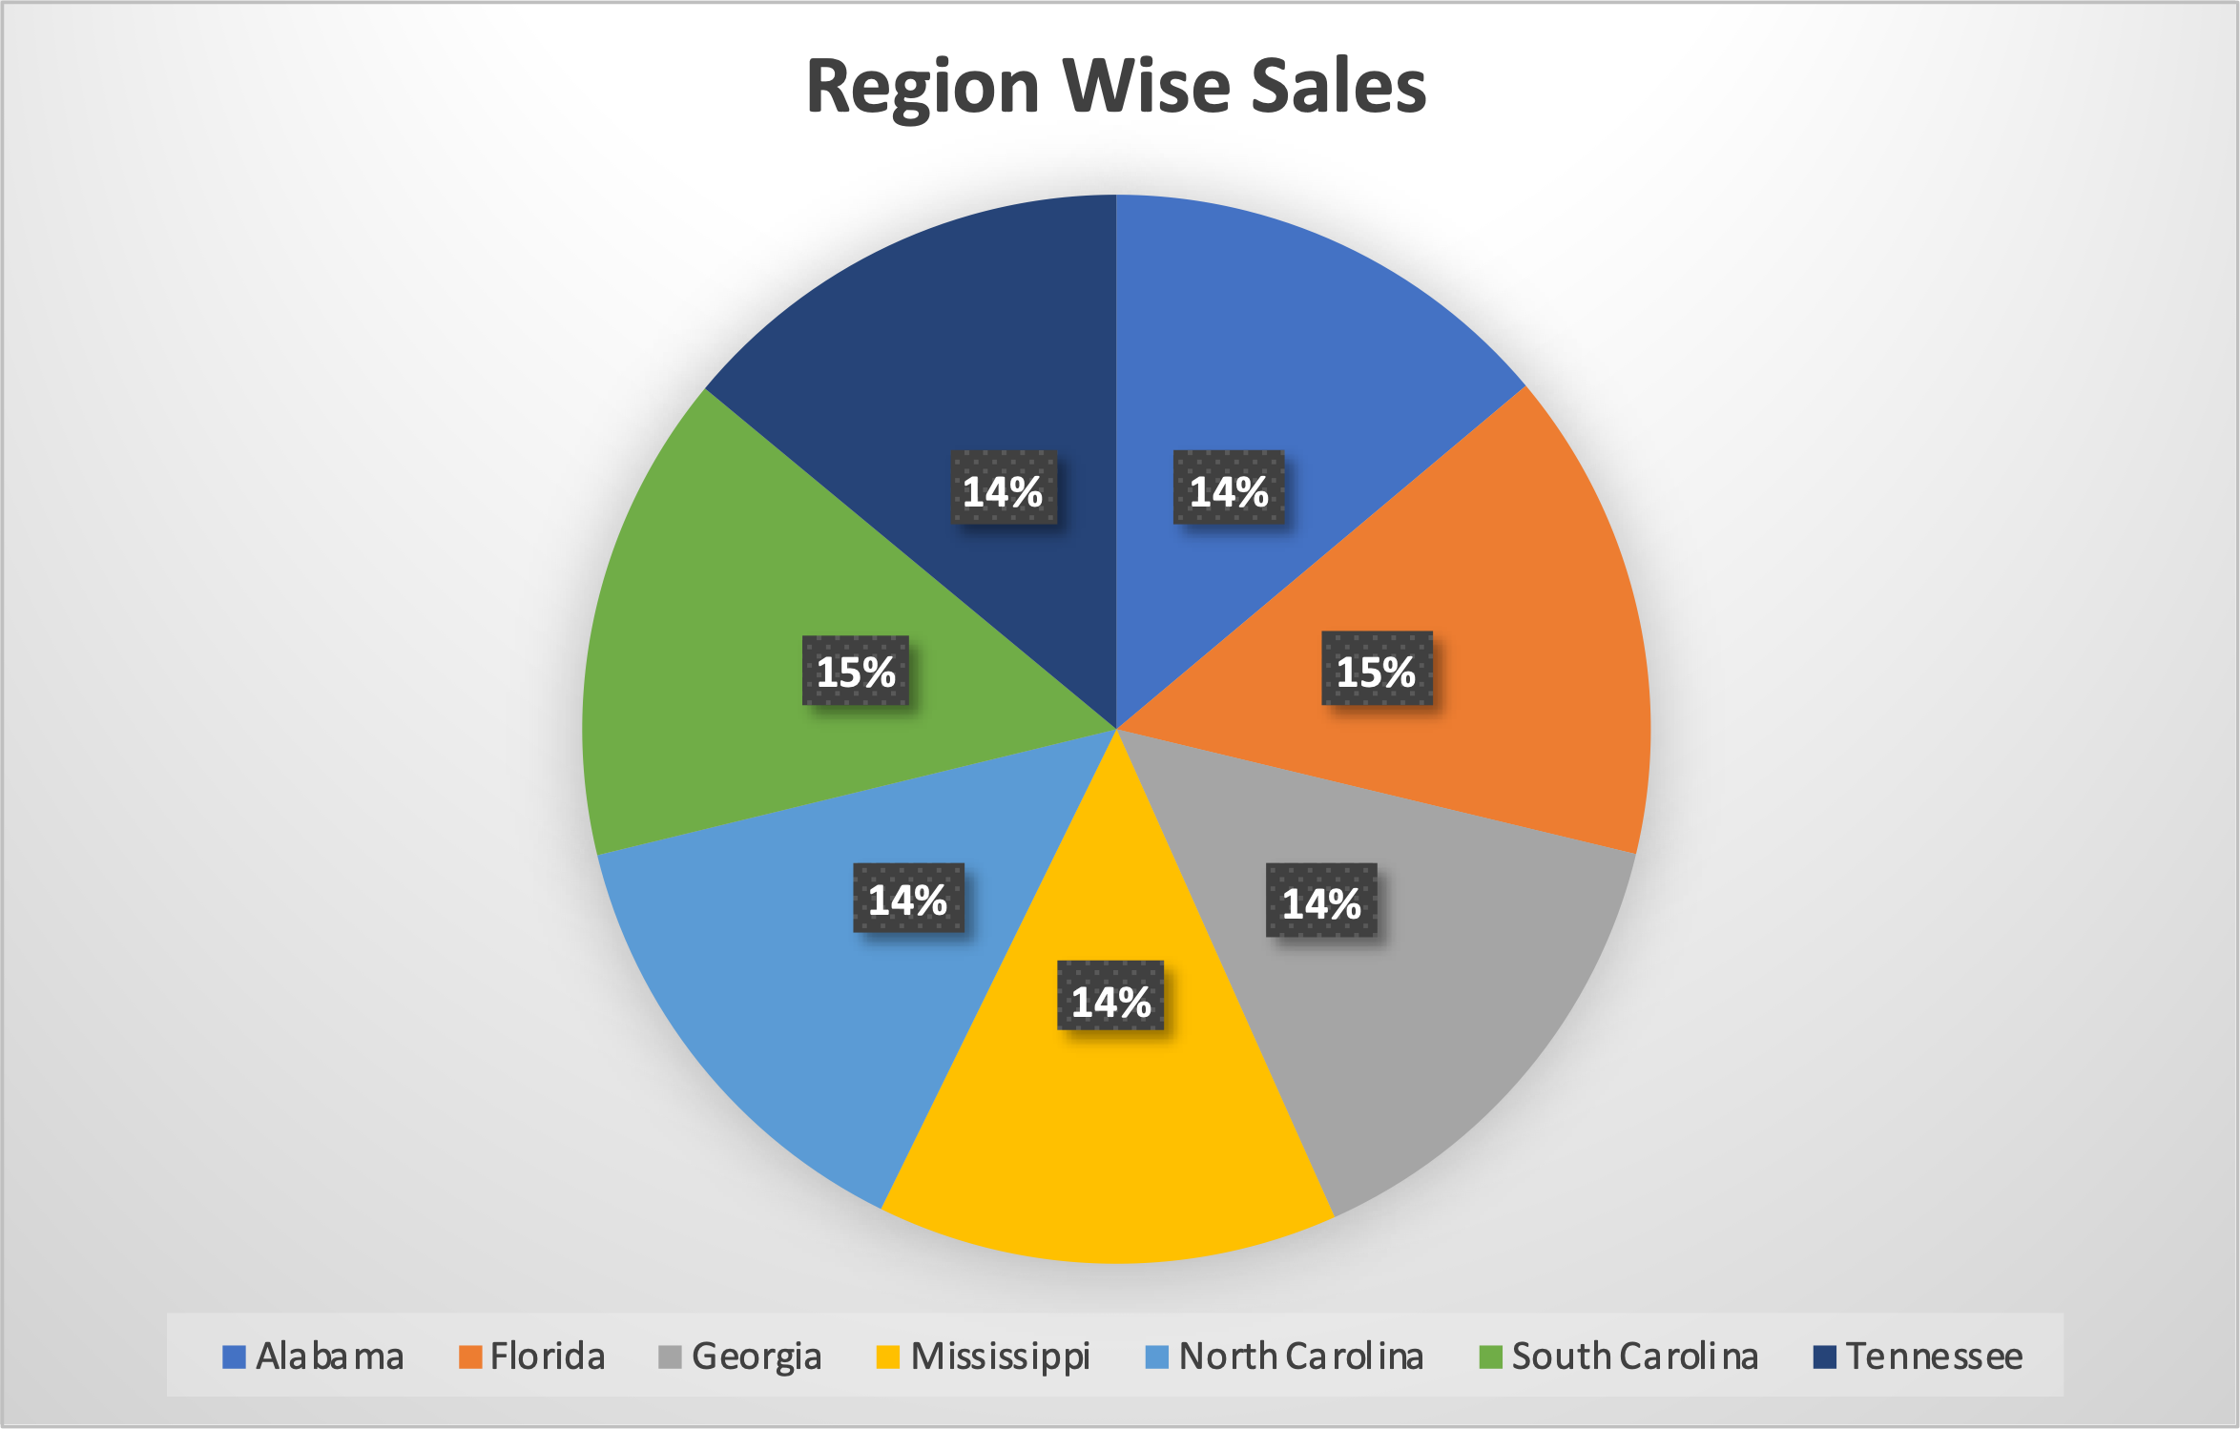
Region Wise Sales
Here I have Created a pie chart in Which Region/state wise
Sales is represented.

Slide 11
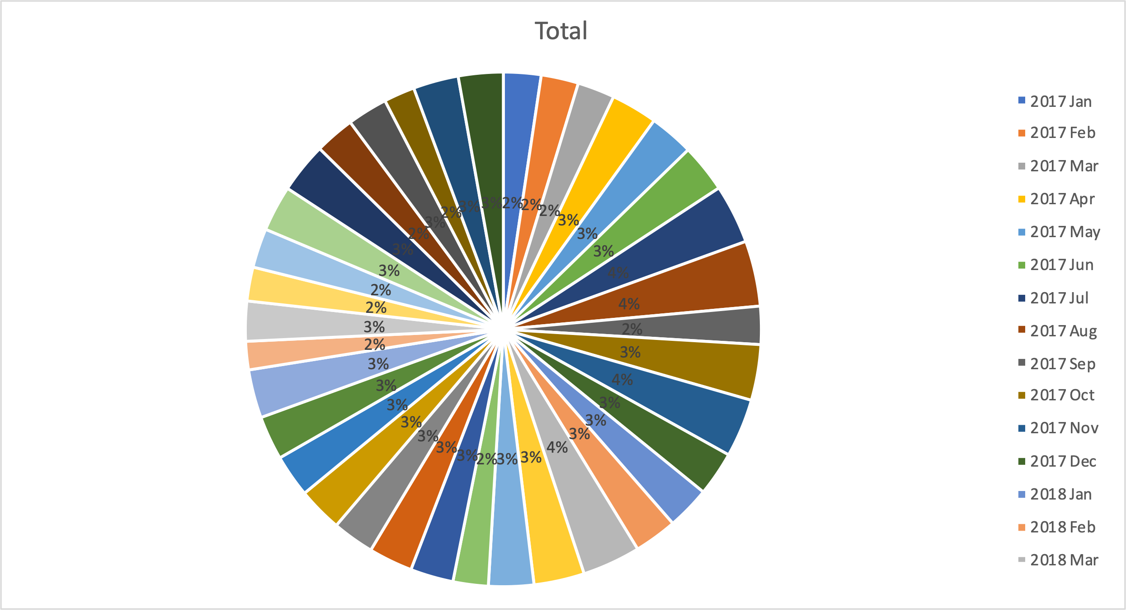
Date Wise Sales
Here I have Created a Pie Chart To Group Sales by Date wise

Slide 12
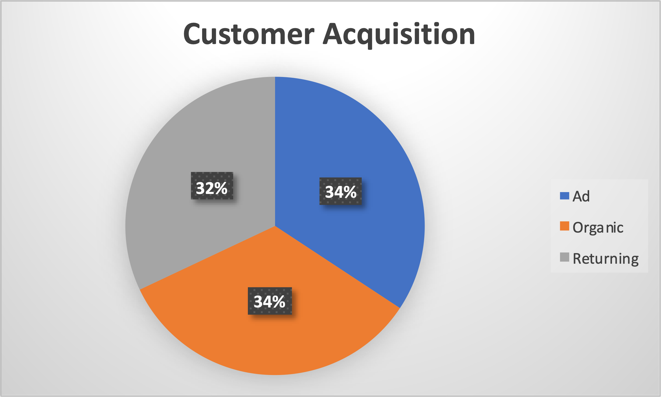
Customer Acquisition
Here Through Pie Chart I Have Divided the customer Acquisition type
In forms of Ad,Organic and Returning types

Slide 13
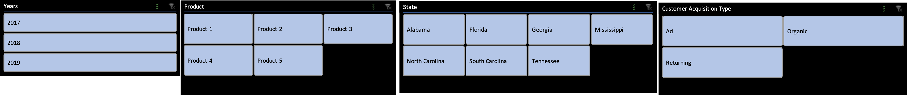
Slicers
The use slicers in Excel to quickly and easily filter pivot tables. Connect multiple slicers to multiple pivot tables to create awesome reports.Here We Used Slicers For Years,Acquisition Type,Product Types And State Wise

Slide 14
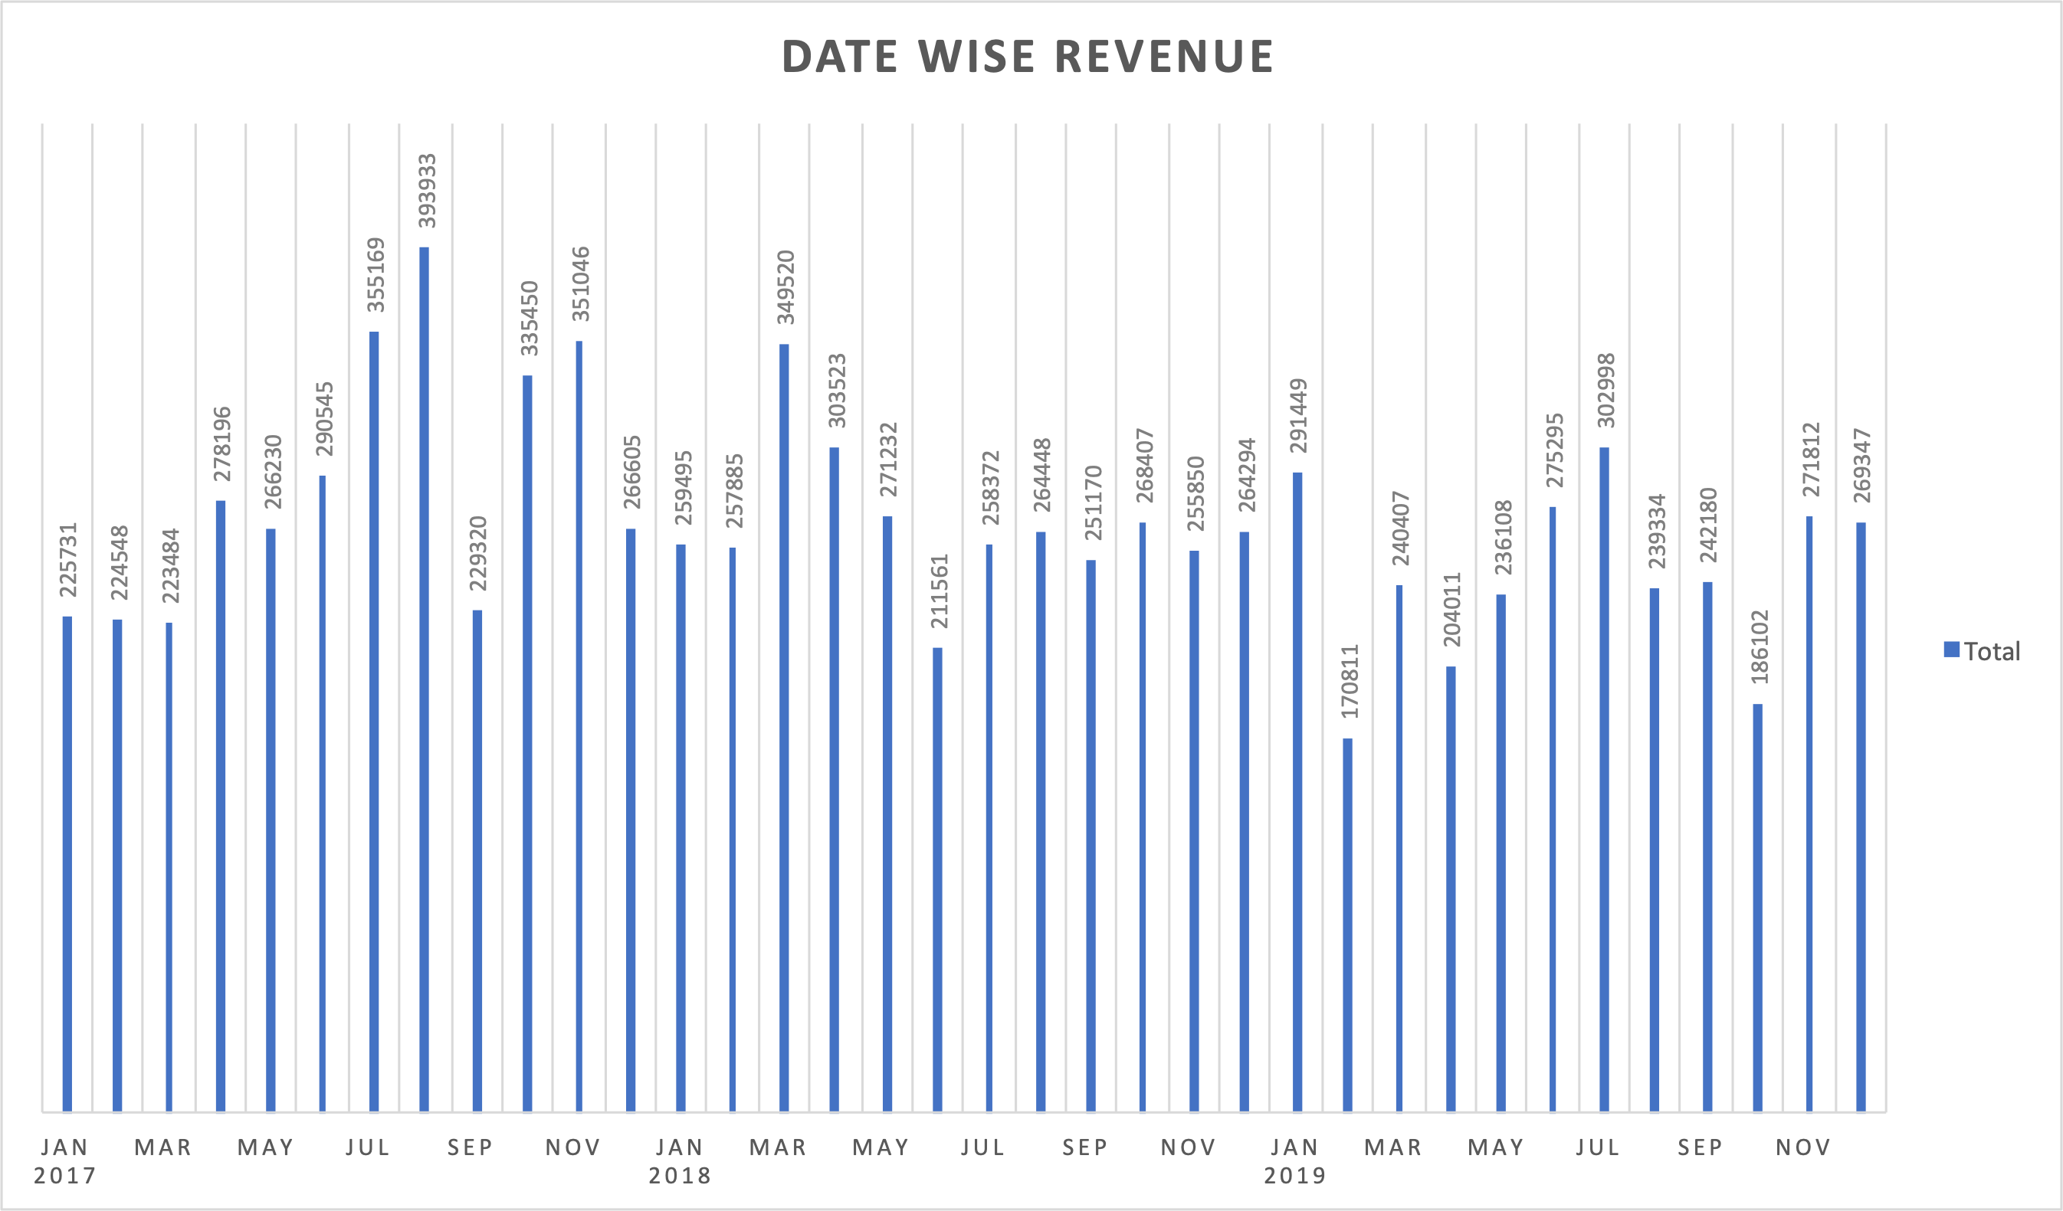
Date Wise Revenue
Here I Have created a Bar Chart in Which Revenue/Sales is represented
By bars And years/Months in X-axis

Slide 15
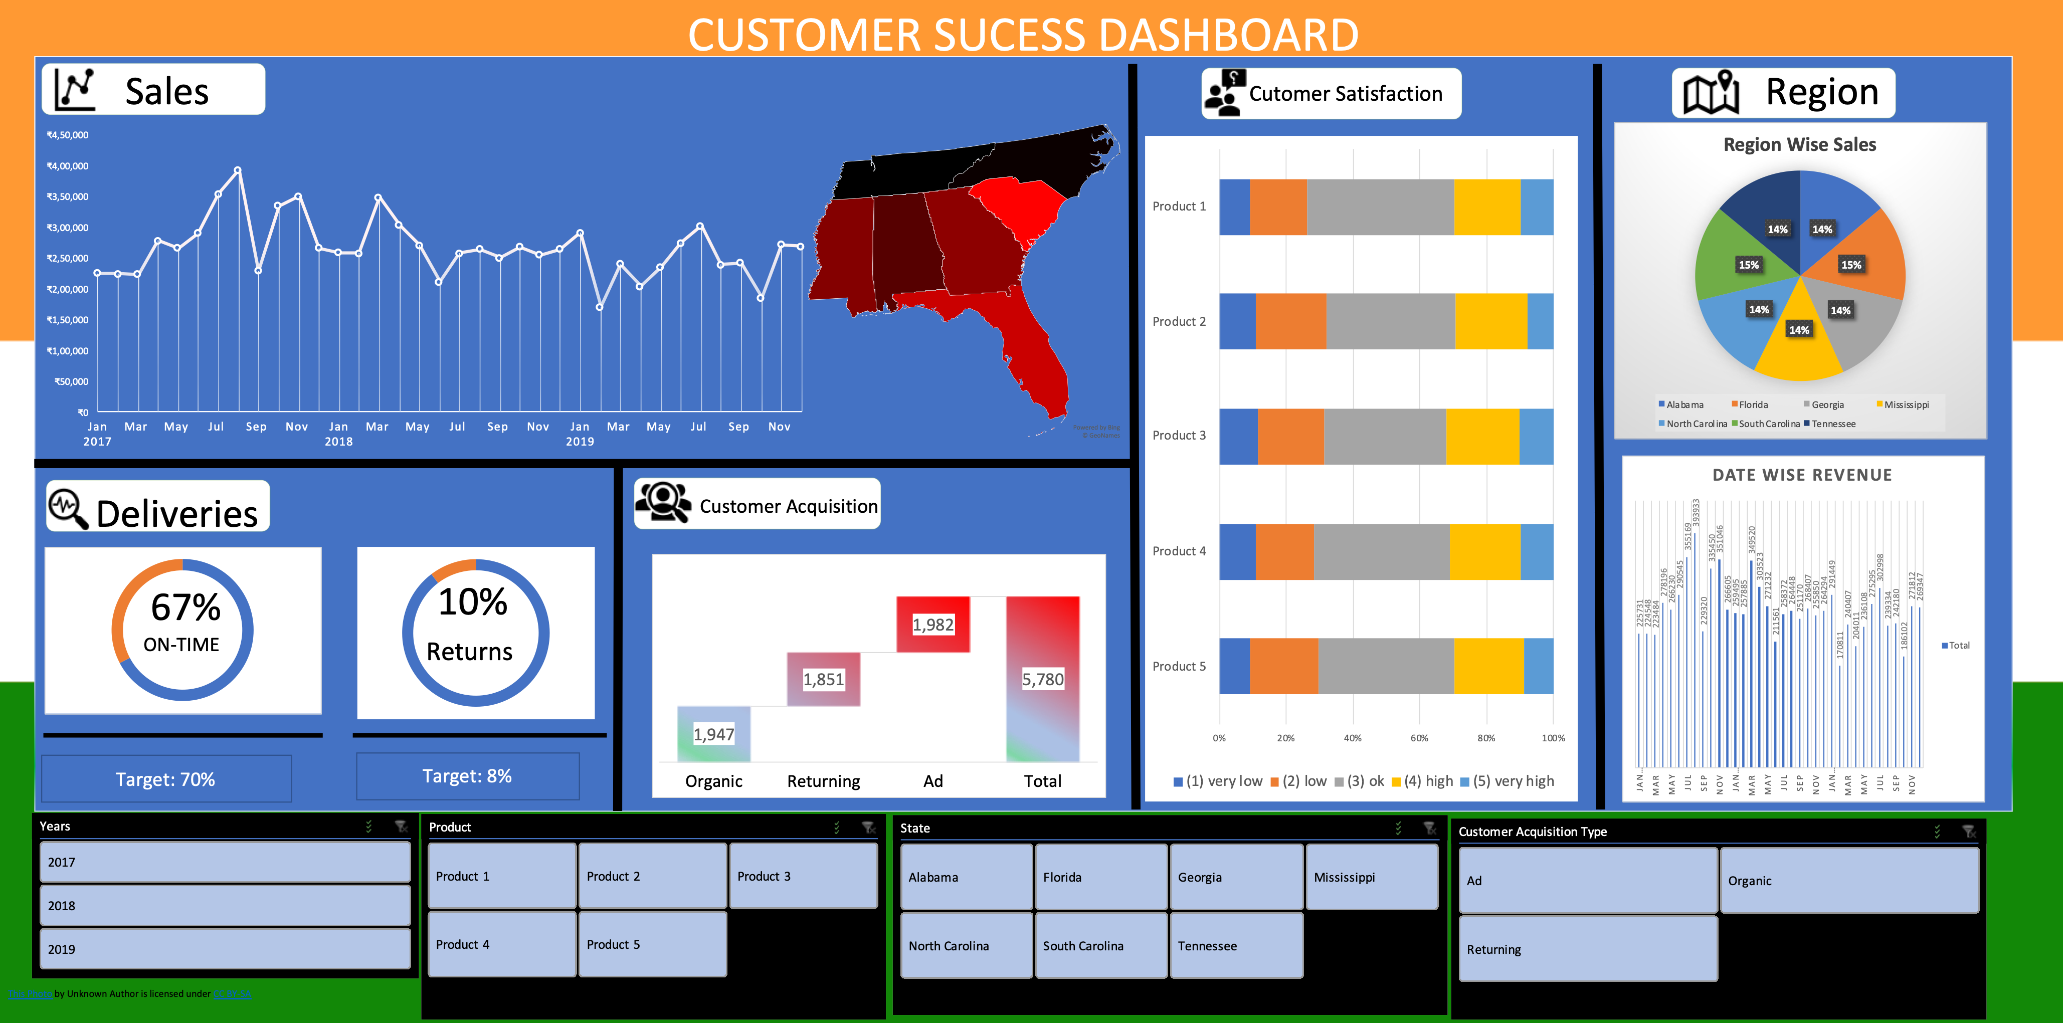

Slide 16
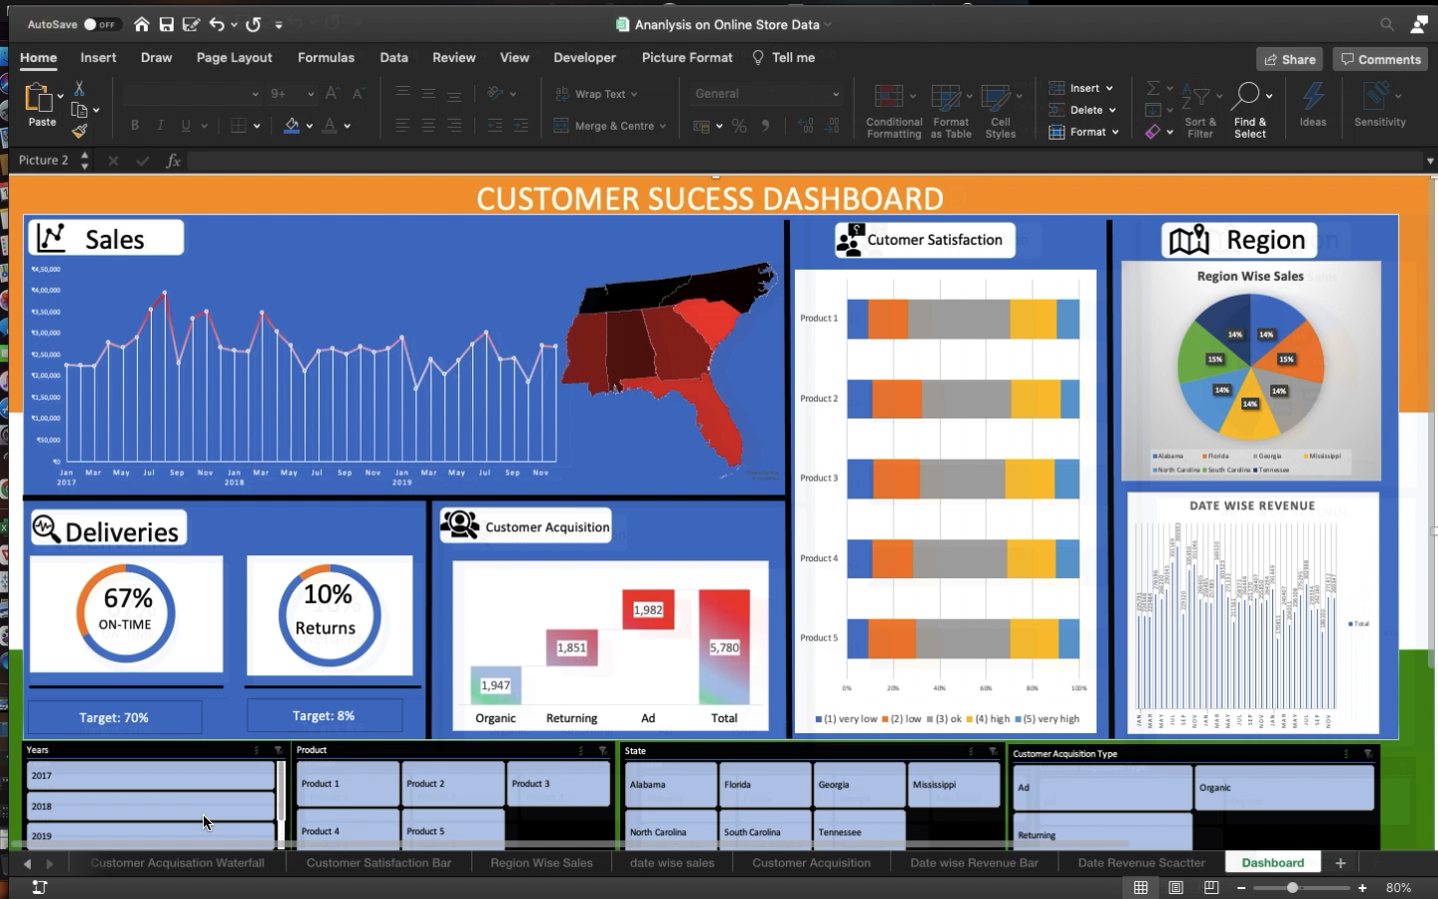

Slide 17
Conclusion
So The Result/Outcome is Suppose when We select 2017 from slicer
Then automatically we get the Month/Year wise Sales,And Its
Respective region through Map Chart,Also We Get Delivery Info
Percentage on time and return percentage,Also With Waterfall Chart We Get Total sales per acquisition,Also We Get Customer satisfaction Through Bar Chart which is basically customer rating of a product From 1 to 5 And Atlas we Get Region Wise Sales Through Pie Chart.Likewise We can select year,Acquisition type, state and products from the slicers to get their respective results in different types of charts which are mentioned in latter slides.And the future scope of this project is I will add a info button which will tell about the information of graph in a dashboard.And also I will add a setting button icon by that we can directly change the theme of the whole dashboard And Atlast If I have to add functionality like when some data is added in the data table then automatically the dashboard will change accordingly.

Slide 18
Here is link to the video reprentation of excel project
https://drive.google.com/file/d/18_iuaYixQqsQEkmcyojKsueURYZ-052P/view?usp=sharing

Slide 19
THANK YOU

